Slide 1


DSI-23 Capstone Project: Analysis on COVID-19 Pfizer/BioNtech Vaccine Tweets
Jeffrey Prasetio

Slide 2

Contents
Background
Sentiment Analysis – VADER
Topic Modelling – BERTopic
Conclusions & Recommendations

Slide 3
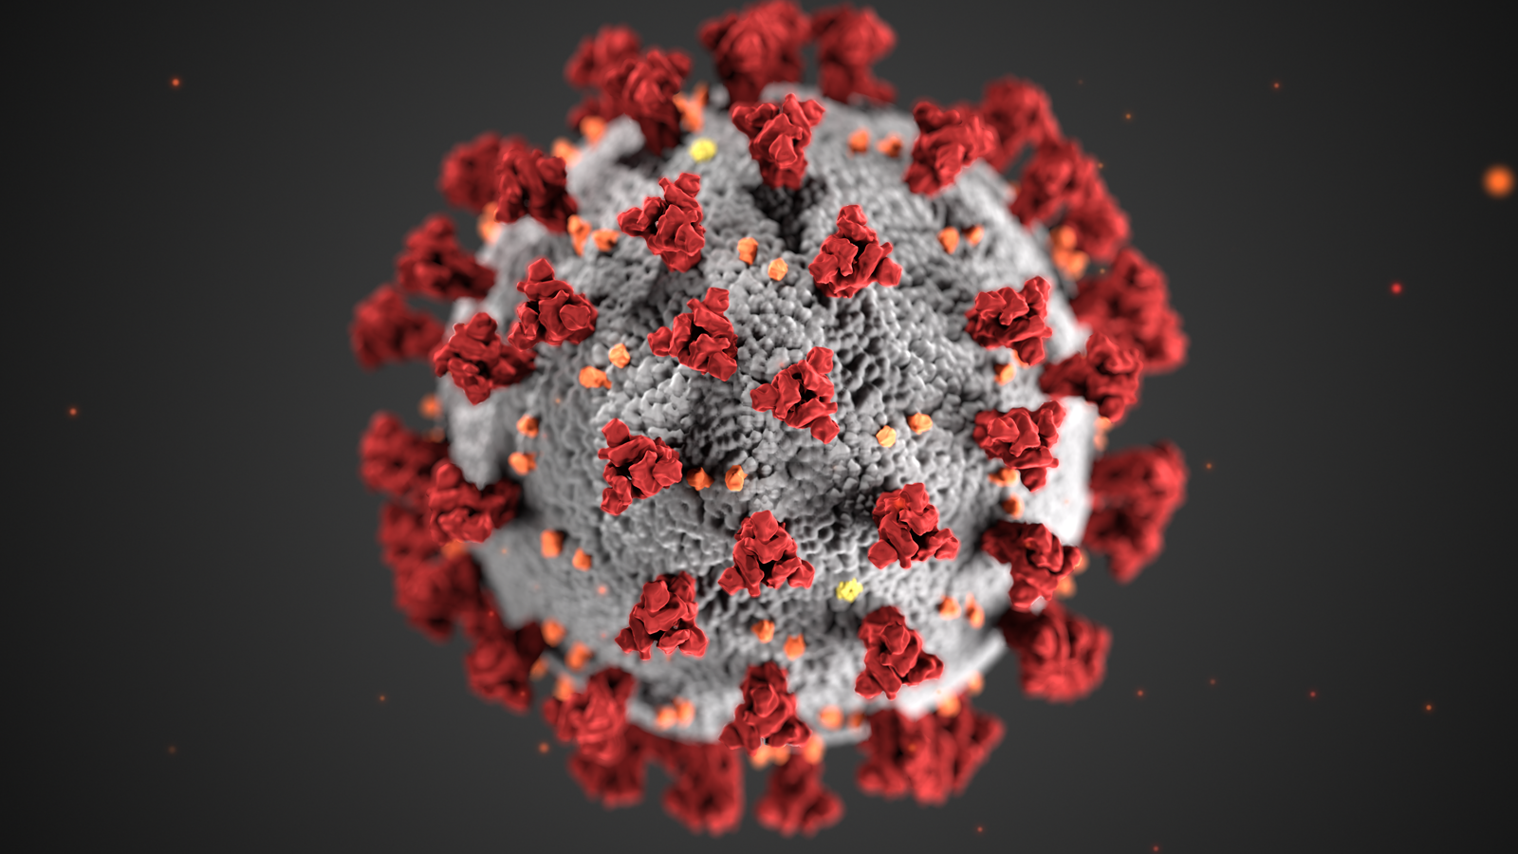
Background
COVID-19 is the disease caused by a new coronavirus called SARS-CoV-2.
First identified in Wuhan, China, in December 2019.
The World Health Organization (WHO) declared a pandemic on 11 March 2020.
As of 31 August 2021, more than 217 million cases and 4.51 million deaths have been confirmed.
The Pfizer/BioNtech vaccine was the first to be listed for WHO Emergency Use Listing (EUL) on 31 December 2020.

Slide 4

Goal
The goal is to identify potential interventions for Pfizer/BioNtech to take, in order to speed up the global vaccination progress (and increase vaccine sales)
Sentiment analysis on the Pfizer/BioNtech vaccine tweets, to understand the overall global sentiment.
Topic modelling within each sentiment, to further understand the possible reasons behind the sentiment.

Slide 5
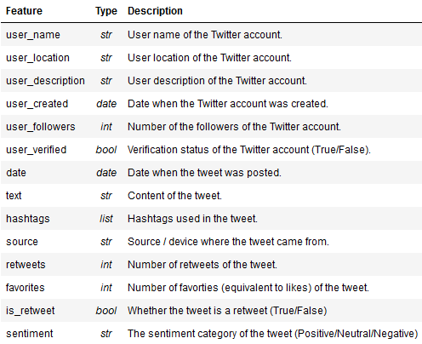
The Data
17172 tweets about the Pfizer/BioNtech vaccine.
12/12/2020 – 22/08/2021.

Slide 6

Sentiment Analysis -VADER
What is VADER?
A lexicon and rule-based sentiment analysis tool, specifically attuned to sentiments expressed in social media.
Text Preprocessing?
Very minimal, VADER is smart enough to understand the valence of non-conventional text: including emojis 🙃, CAPITALIZATION, and extended punctuation!!!!!!!
Sentiment Scoring?
Positive: compound score >= 0.05
Neutral: -0.05 < compound score < 0.05
Negative: compound score <= -0.05

Slide 7
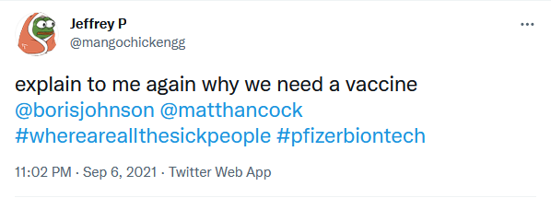
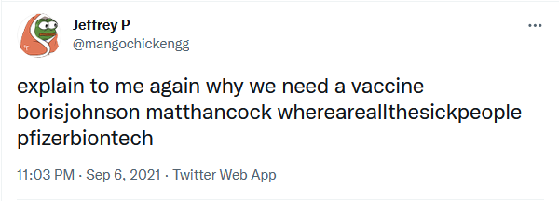
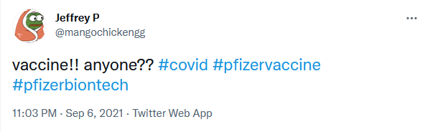
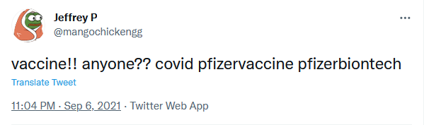

Slide 8
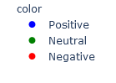
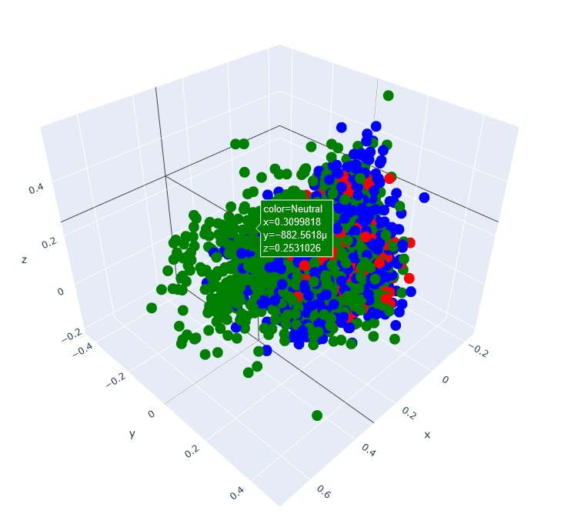
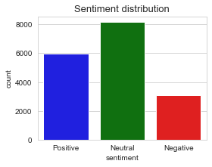
Sentiment Clusters
The clusters (generated with a PCA scatterplot) do not seem very distinct from one another.
This is rather concerning, but also understandable because the distinctions between sentiments are typically not straightforward.
Sentiment classification is a highly subjective task.

Slide 9
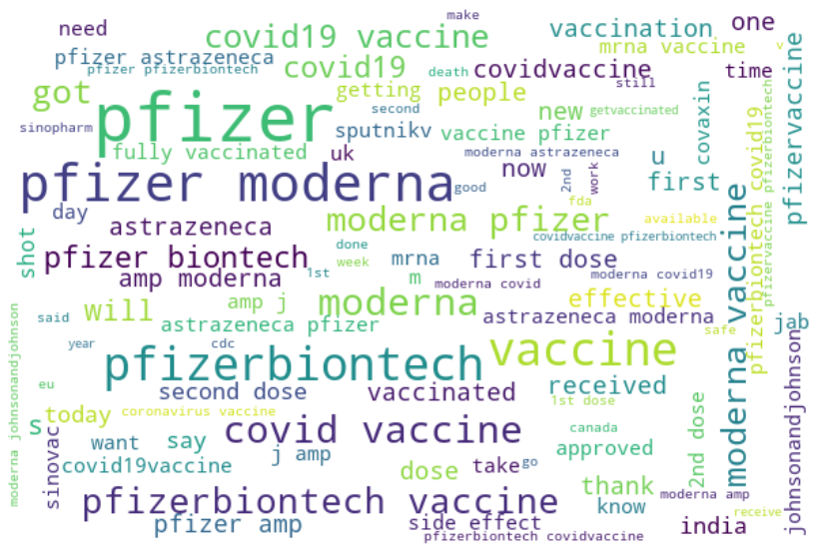
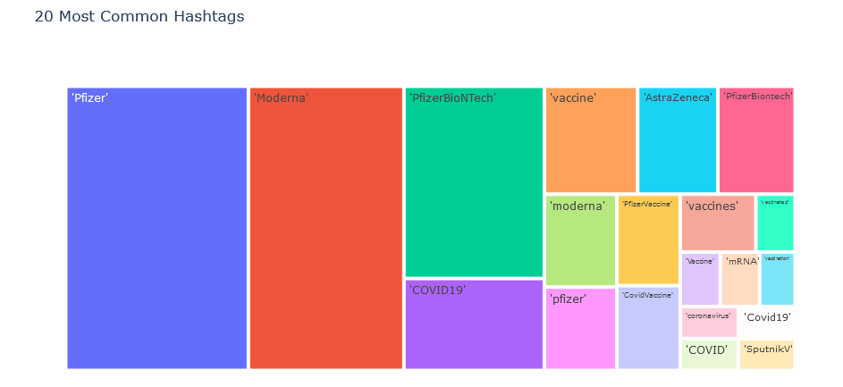
Insights – Word Cloud

Slide 10
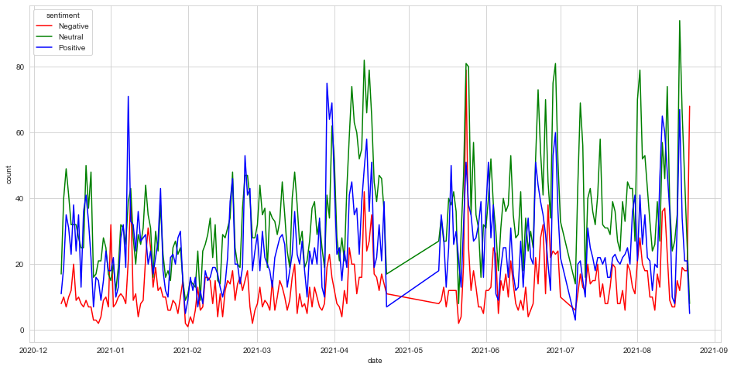
Insights – Time Trends
Notes:
The data consists of tweets from December 2020 til August 2021.
In the initial stages up to February 2021, the number of positive, neutral, and negative tweets often overlapped with one another, perhaps due to mixed opinions of the newly launched vaccine.
Afterwards, the neutral tweets took the top spot, followed by positive and negative - this pattern remained fairly consistent til May 2021. In the latter half of May 2021, there was a huge spike in negative tweets. This is highly likely due to the emergence of the Delta variant outbreak in India.
Lastly, towards the end of August 2021, there was another spike in negative tweets. This was largely due to discussions about how Pfizer is less effective against the Delta variant.
Coincidentally, the last collected tweet was on 22 August 2021. Though unrelated to the delta variant, the Pfizer vaccine received FDA's approval on 23 August 2021. It would be interesting to see how online sentiment develops further.

Slide 11
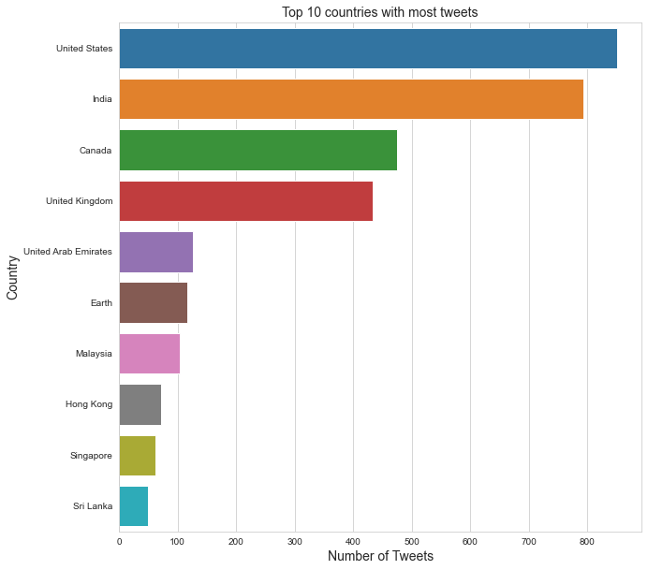
Insights – Top 10 Countries
Notes:
Above are the countries with most tweets. There is 25% missing data for user locations, as it is not mandatory for Twitter users to fill in the location information. In addition, the location information is not a drop-down selection, and users are able to freely type in their locations. As a result, there are many variations in how users specify their locations, thus the location data is not standardized. I have grouped the top occurrences to the country-level for a more accurate representation.

Slide 12
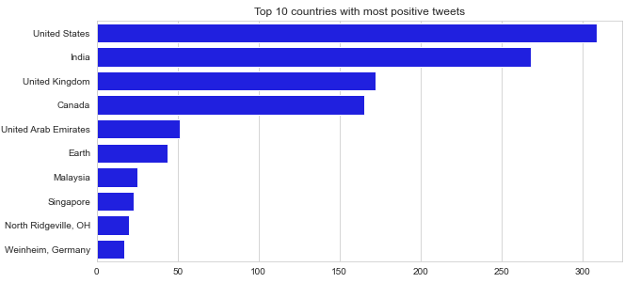
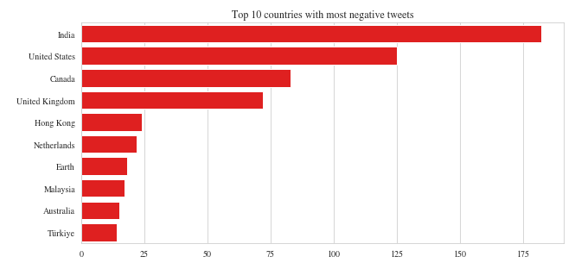
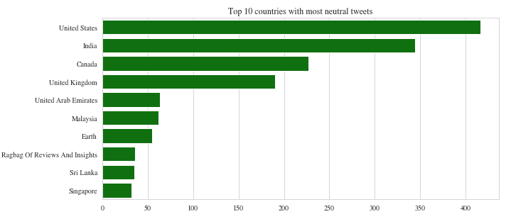
Insights – Top 10 Countries
Notes:
The top countries in all sentiments are very similar. In general, the countries with high tweet count will take the top spots.
It is unsurprising that people within a country have mixed opinions on the Pfizer vaccine (or any vaccine).

Slide 13
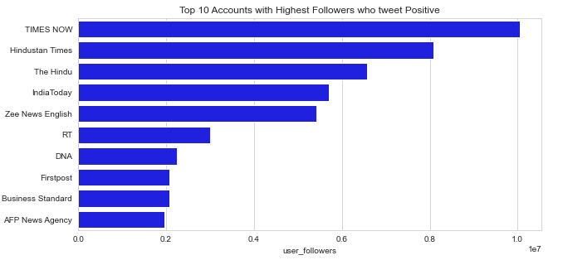
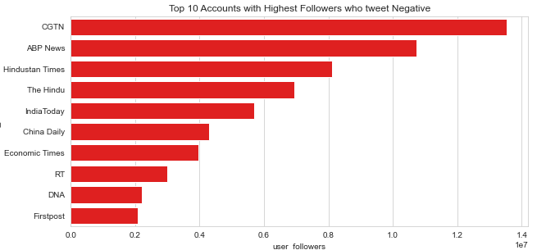
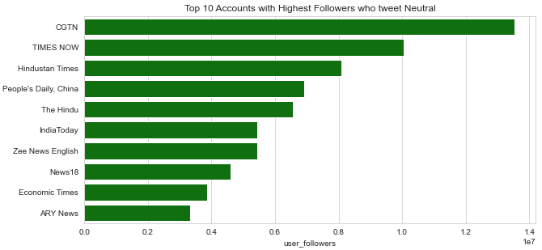
Insights – Accounts w/ most followers
Notes:
There isn't much insight to see from the top accounts with highest followers. These accounts are mostly news channels - and news channels are expected to tweet about all positive, neutral, and negative news.

Slide 14
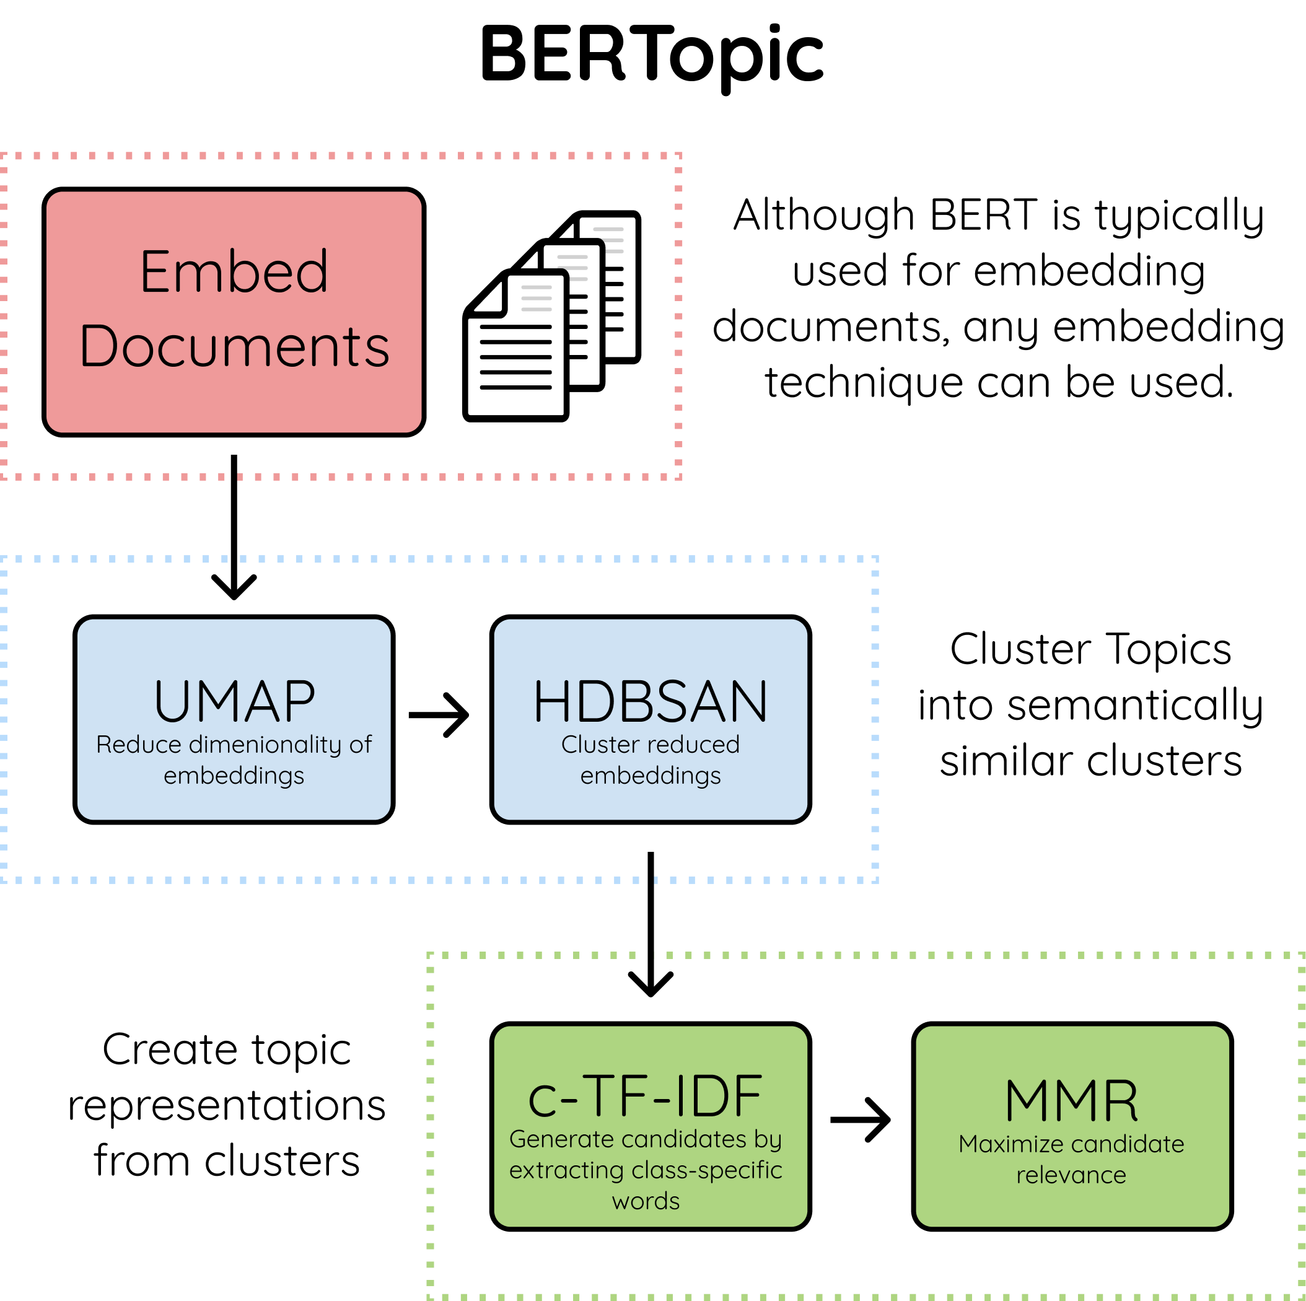

Topic Modelling
What is BERTopic?
BERTopic is a topic modeling technique that leverages transformers and c-TF-IDF to create dense clusters allowing for easily interpretable topics.
Embedding Model?
paraphrase-mpnet-base-v2 (a model that provides a higher quality, but takes more compute time)

Slide 15
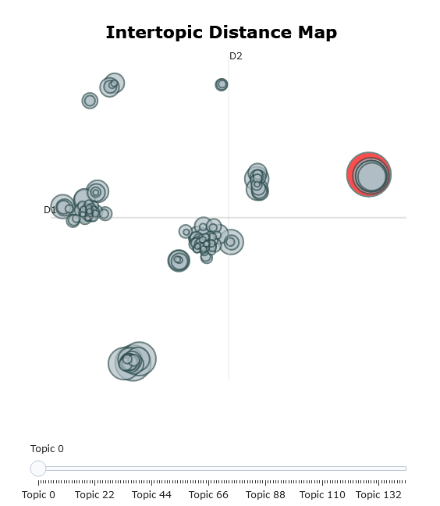
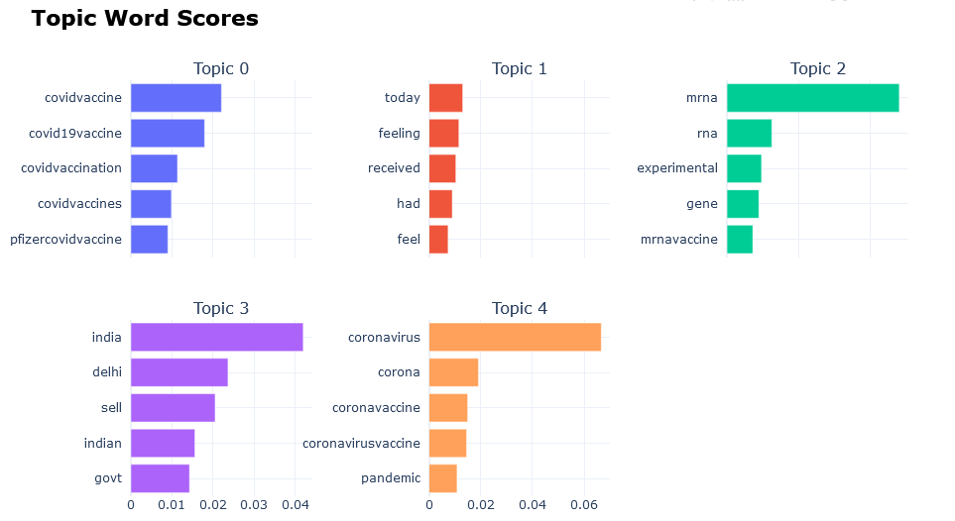
Topic Clusters

Slide 16
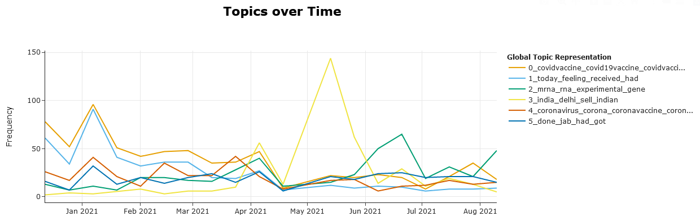
Topics over Time

Slide 17
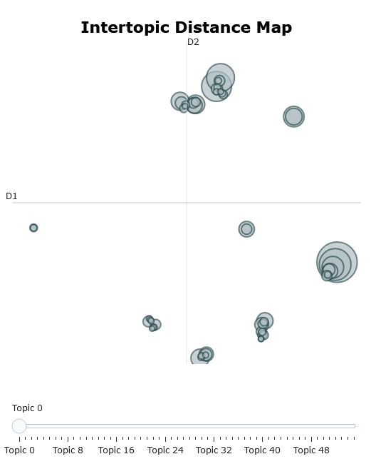
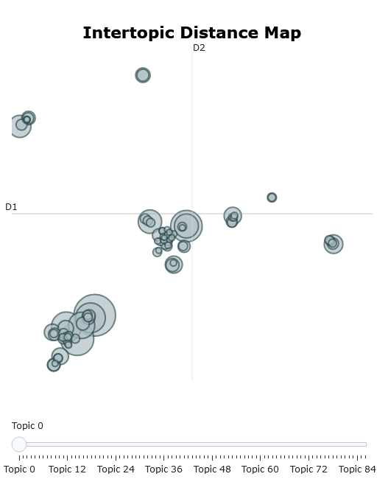
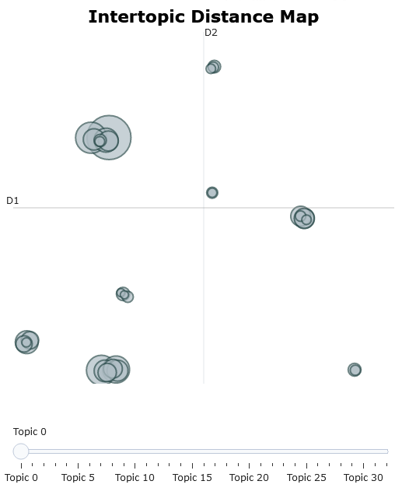
Topic Clusters
Positive
Neutral
Negative

Slide 18
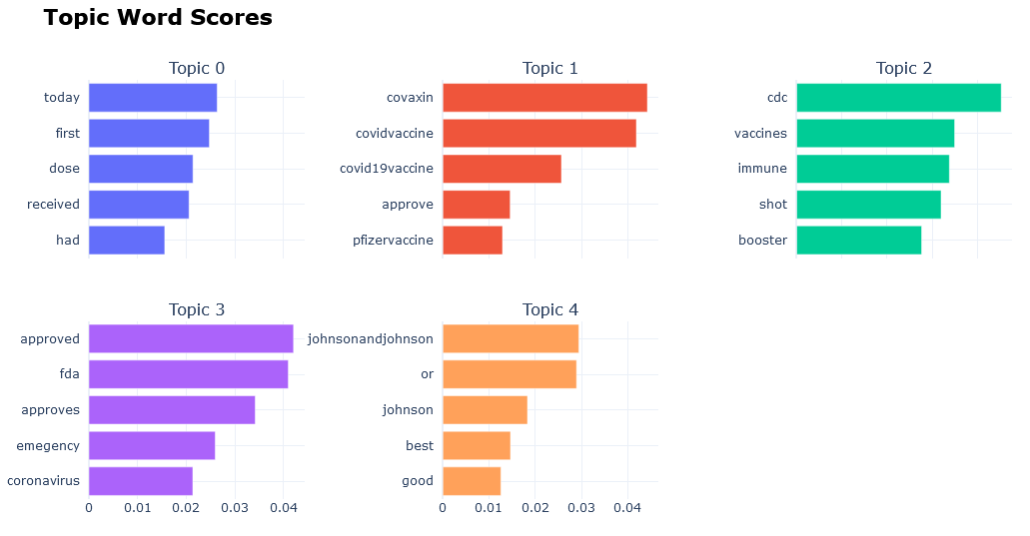
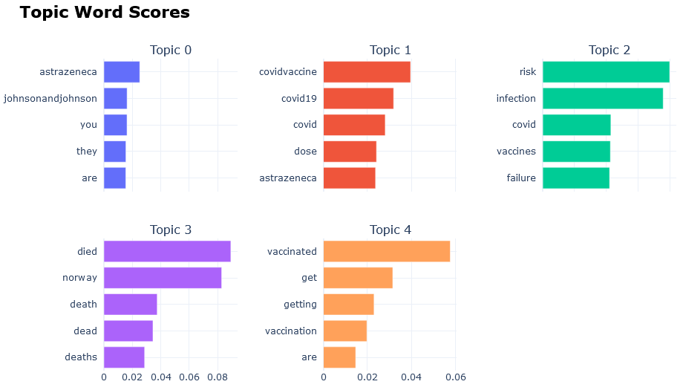
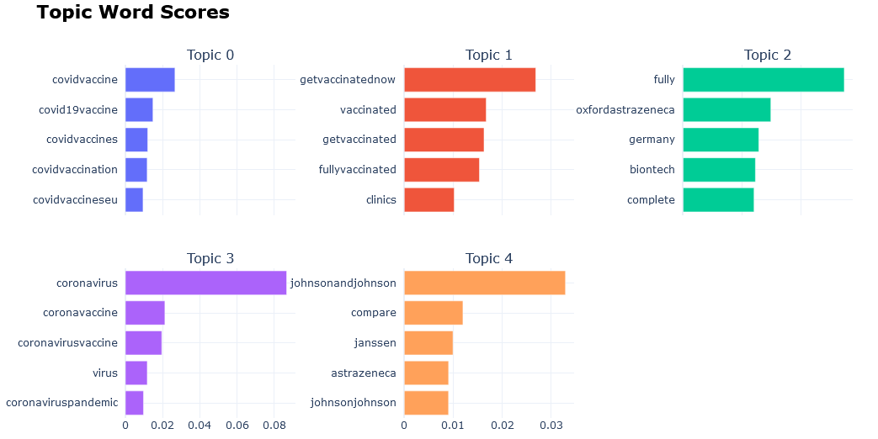
Topic Word Scores
Positive
Negative
Neutral

Slide 19
Conclusions & Recommendations
Although the Pfizer/BioNtech vaccine received the FDA approval on 23 Aug 2021, it was preceded with negative sentiment about how the vaccine is less effective against the Delta variant (Israel outbreak). In order to leverage on the FDA approval status, the company will have to address this controversy - if it's true, perhaps more R&D will have to be invested into a 'vaccine upgrade'. From the sentiment analysis, we saw that the highest negative spike was due to the Delta variant outbreak in India.
As seen from the sentiment distribution within each country, there is no obvious country with tremendously positive sentiment towards the Pfizer/BioNtech vaccine. As such, when it comes to location targeting, the company should look towards countries with the large populations and lowest vaccination rates.
The Johnson & Johnson vaccine was received positively due to its effectiveness against the Delta variant. In return, the Astra Zeneca vaccine has had a negative history of problems. The company should study other vaccine manufacturers and learn directly from their competitors.

Slide 20
THE END

